Slide 1




Project 4: Machine Learning with Video Games
Melina Heredia
Chey Flammer
Dylan Castillo
Ray Rappa

Slide 2

Idea 1:
User-Score/Hit Game Prediction
Dataset: https://www.kaggle.com/c/acm-sf-chapter-hackathon-small/data
This idea will aim to predict whether or not a game is a hit and the score a user would give.

Slide 3

Objective
Our aim for this data analyst project was to predict whether or not a game was a hit or not.

Slide 4

Exploring the Data
The necessary data was already collected and structured into CSV files on Kaggle. We explored our data using pandas to read our csv into a dataframe and viewed the first 5 results using head() to give us an idea of what our data looked like. Investigating the data further we created bar charts to visualize features of interest; comparing game count by platform, developer, publisher, and genre in separate charts. We also explored critic-score by global sales to see what kind of correlation there may be.

Slide 5
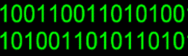
Data Wrangling
Our data was nicely organized for visualizations but far from perfect for us to plug into our Machine Learning model. Beginning our wrangling process we needed to drop any duplicated rows and null values. Perfect, now that our data was somewhat optimized we wanted to figure out which feature would be useful in defining a game as “hit”. We decided that any game that had a global sales over 10 would return 1 and anything under would return 0 saving those values to a new column called “Hit”.

Slide 6

Data Preprocessing
Since our predicting value was a binary outcome either being 1 a “hit” or 0 a “no hit” we decided to go with Random Forest and Logistic Regression.The features we would be using from our original data frame would be “Name”, “Platform”, “Genre”, “Publisher”, “Year_of_Release”, “Critic_Score” and an additional column we created “Hit”. We then used get_dummies to convert our categorical data into indicator variables and after we split our data into “X” and “y” dataframes to separate our data from our labels. Finally, we used train_test_split to create a .75/.25 split into training and test data.

Slide 7
Modeling the Data
The first model we tested was the Random Forest which gave us an accuracy score of .84 and our second model we tested was the Logistic Regression which gave us a slightly higher accuracy score of .86 which is the percentage of correct predictions. Our precision which is the percentage of positive predictions correct was 0.71. Our sensitivity which is our true positive rate 0.71 as well. Finally, our F1 score, which is the balance between precision and sensitivity, was .92.

Slide 8





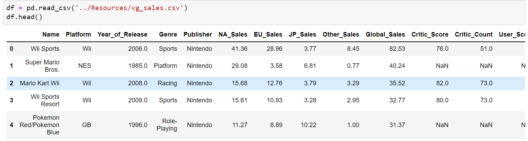

Slide 9
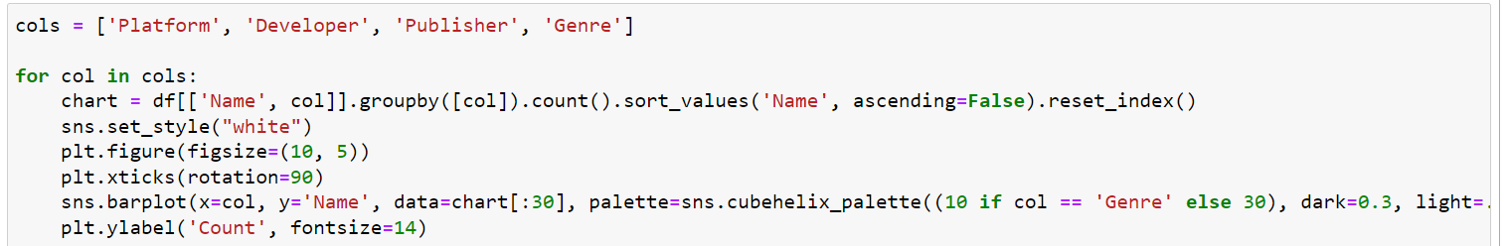

Slide 10
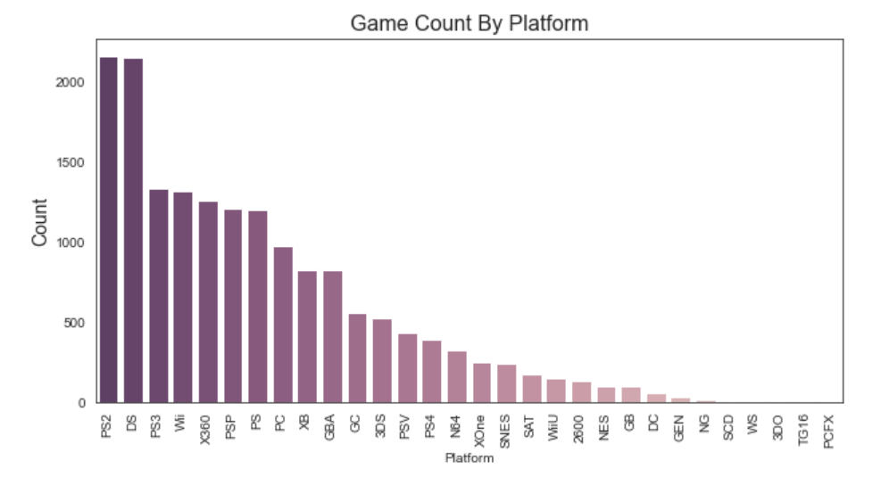

Slide 11
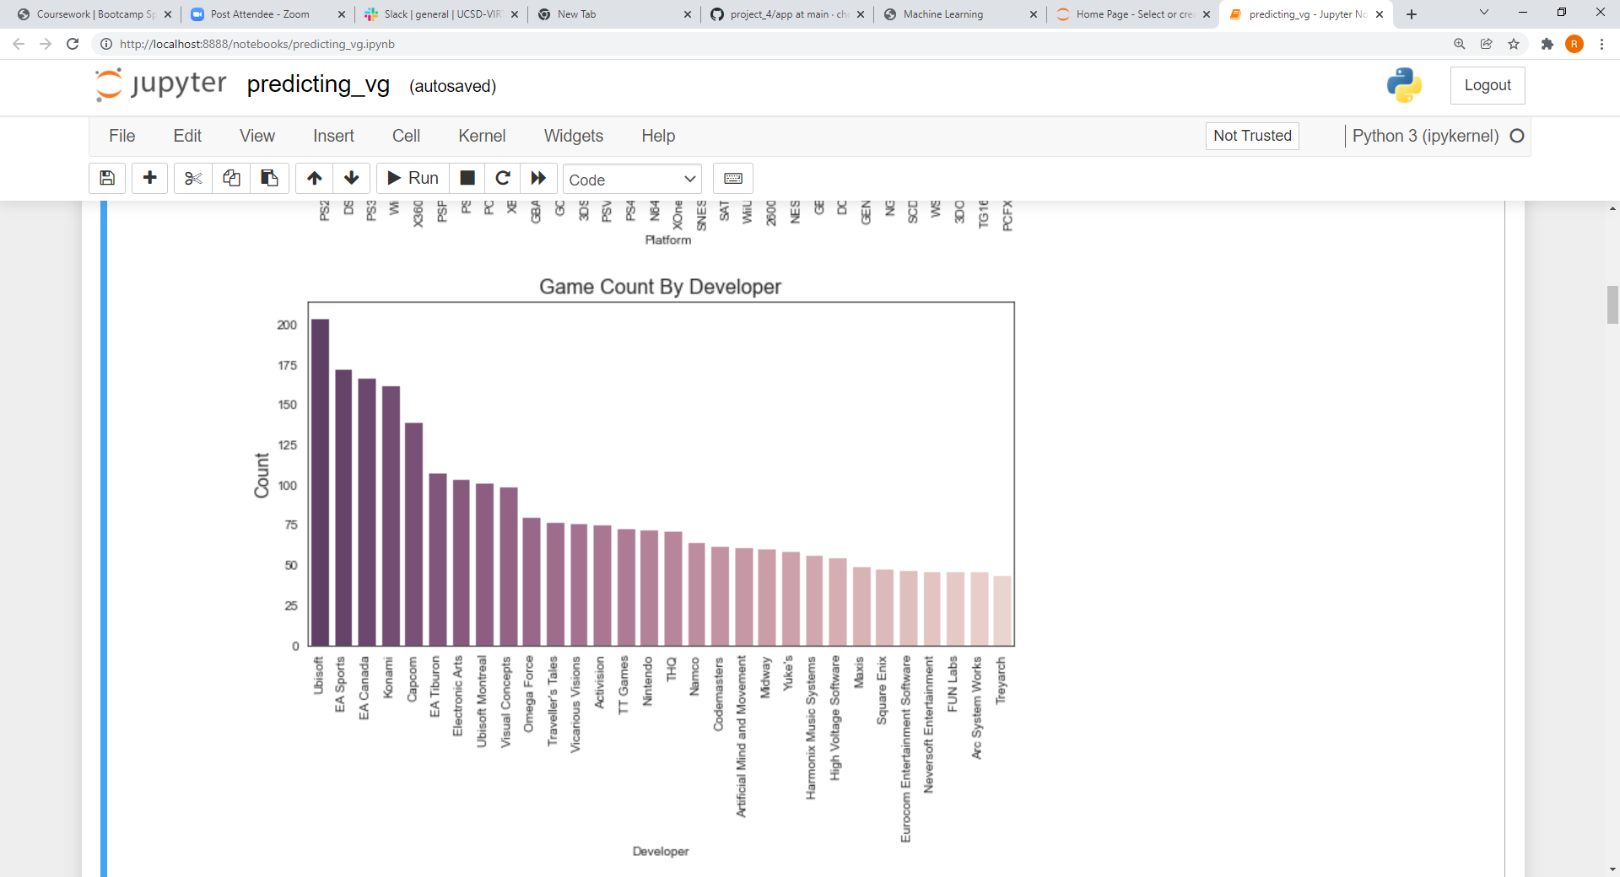

Slide 12
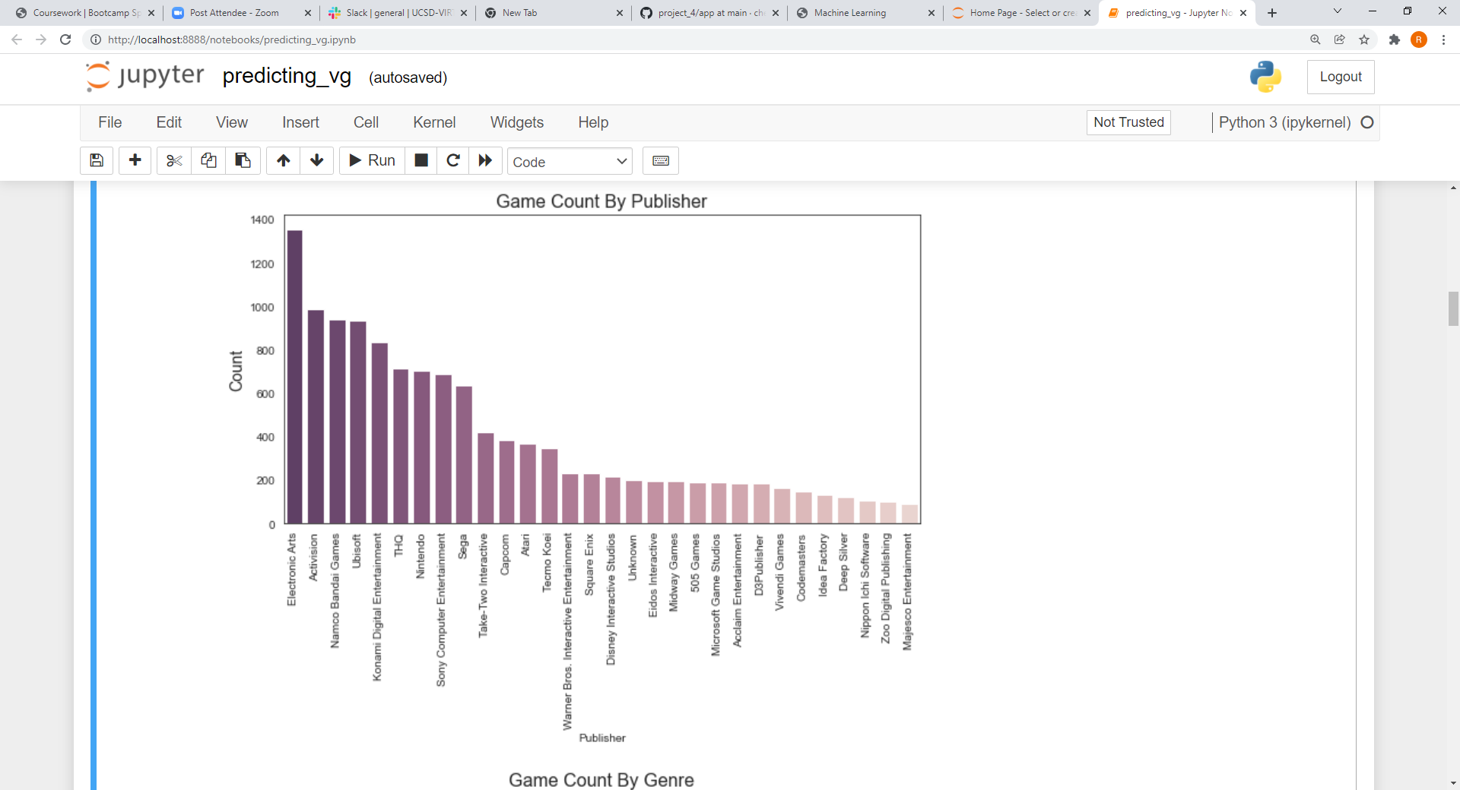

Slide 13
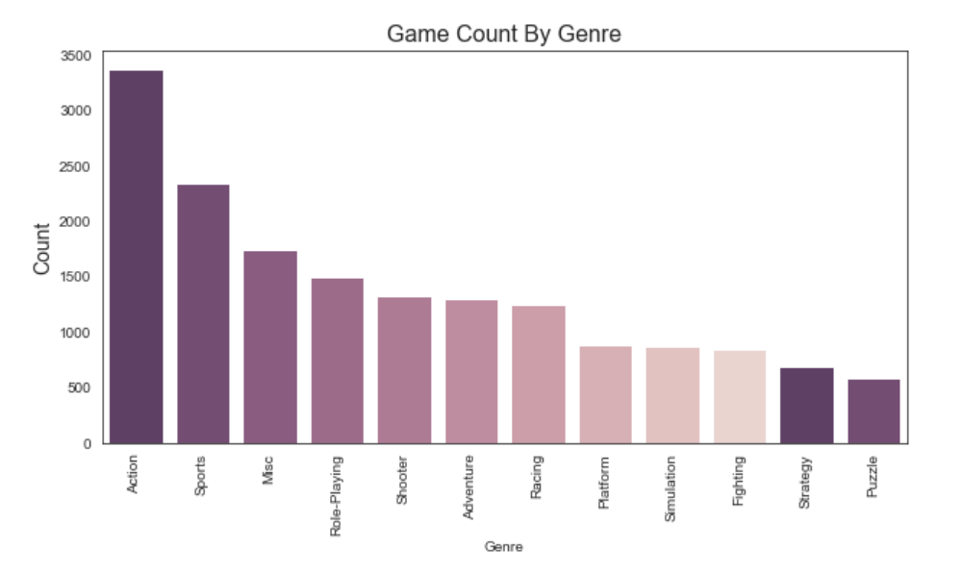

Slide 14
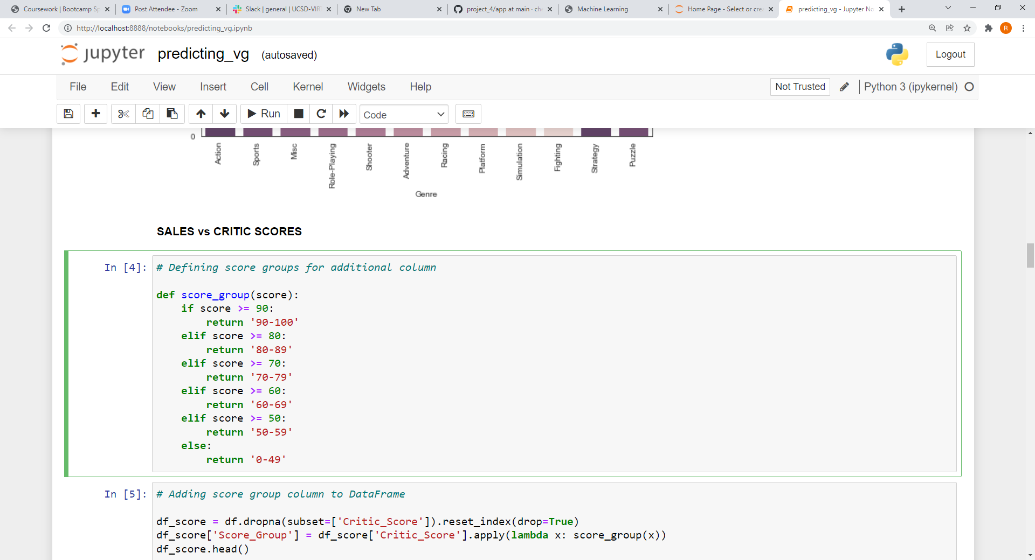
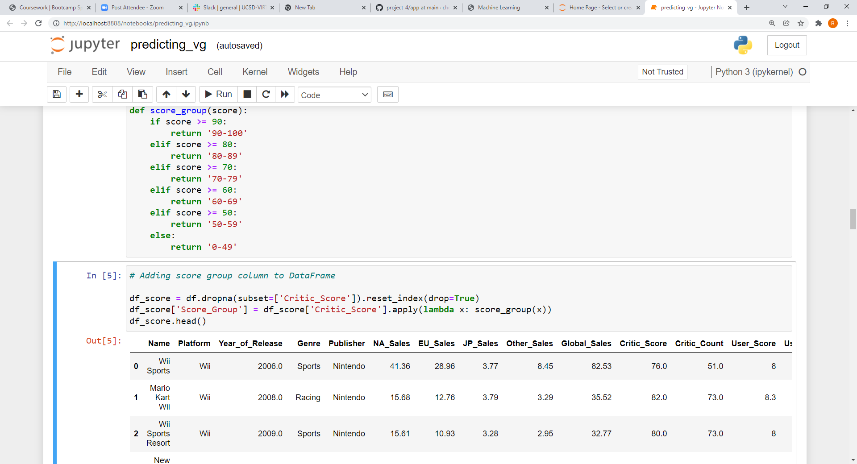
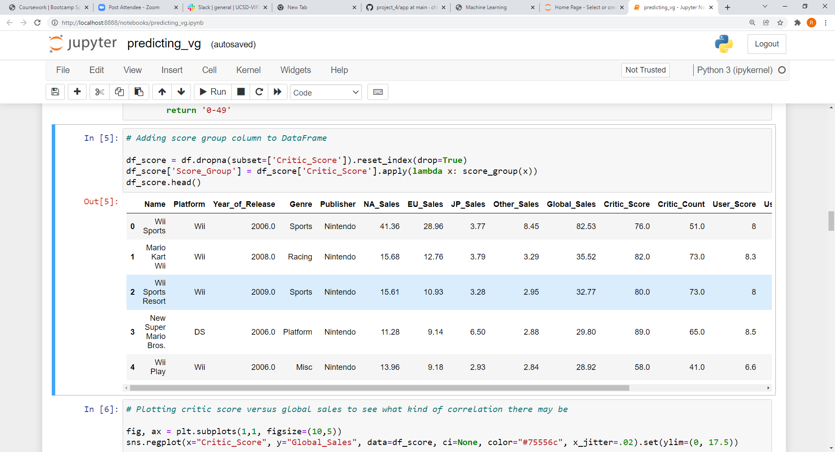

Slide 15
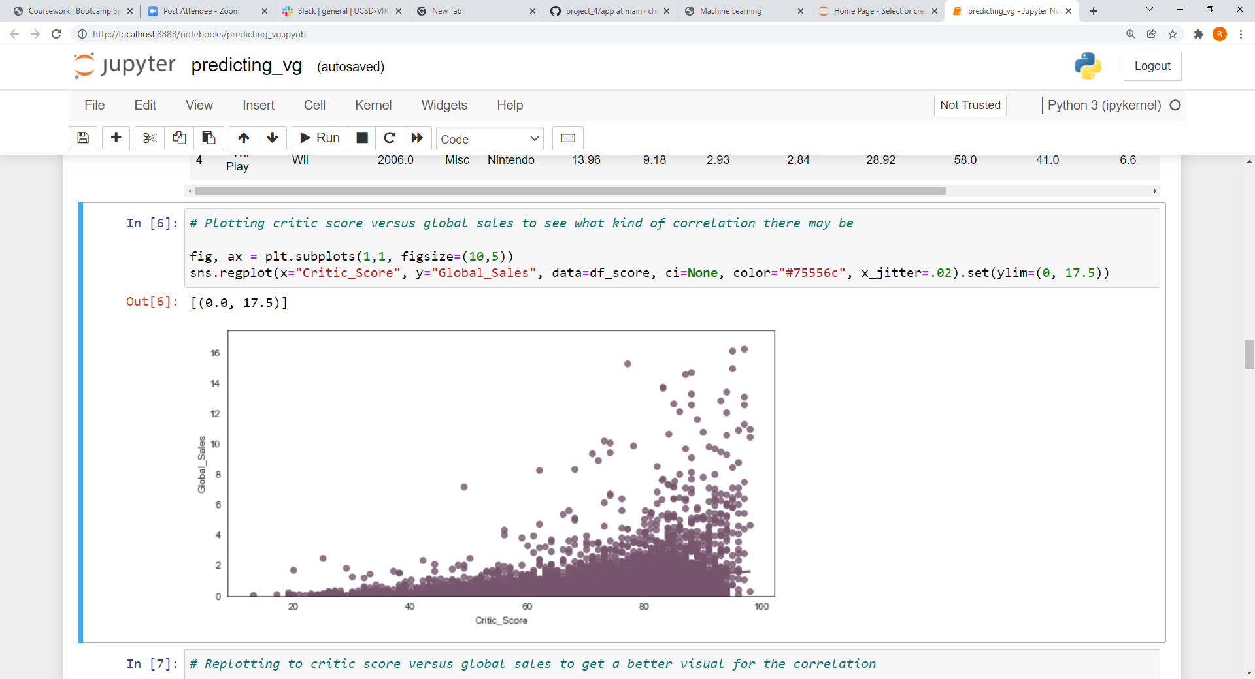
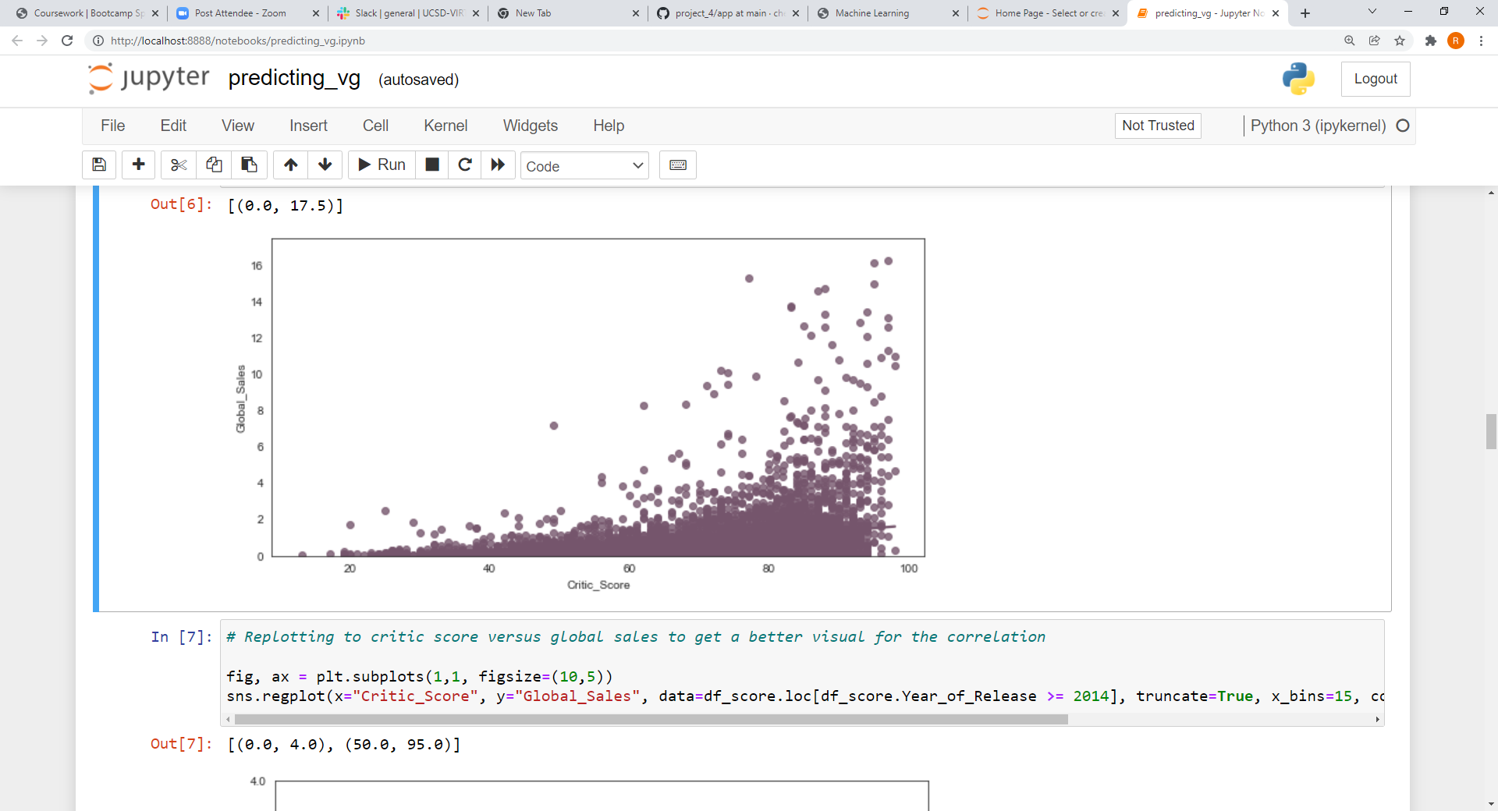


Slide 16
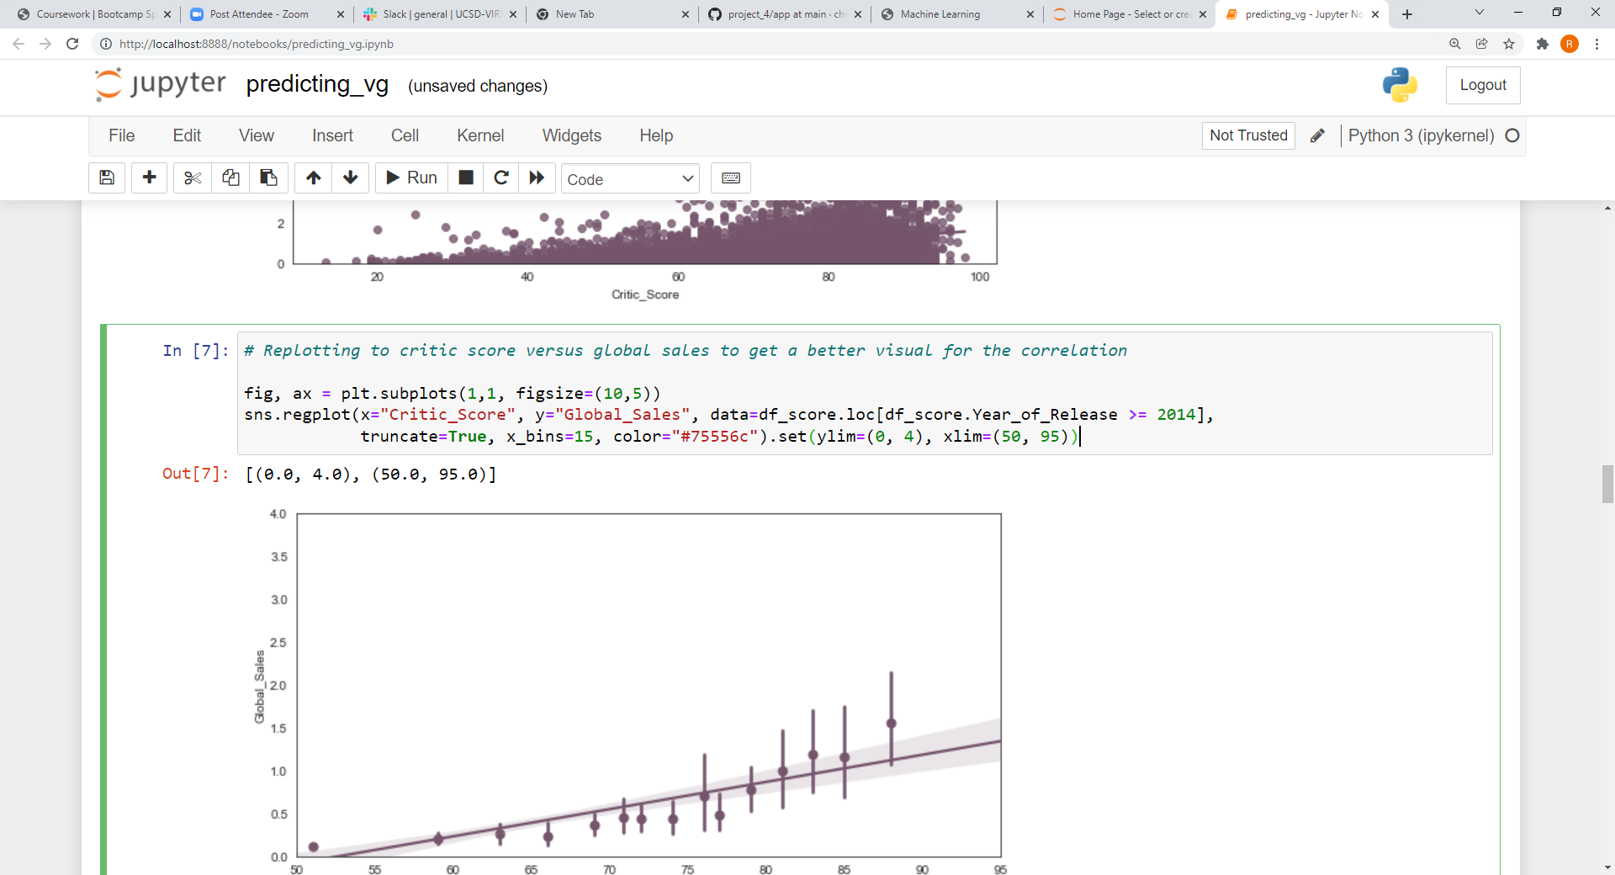
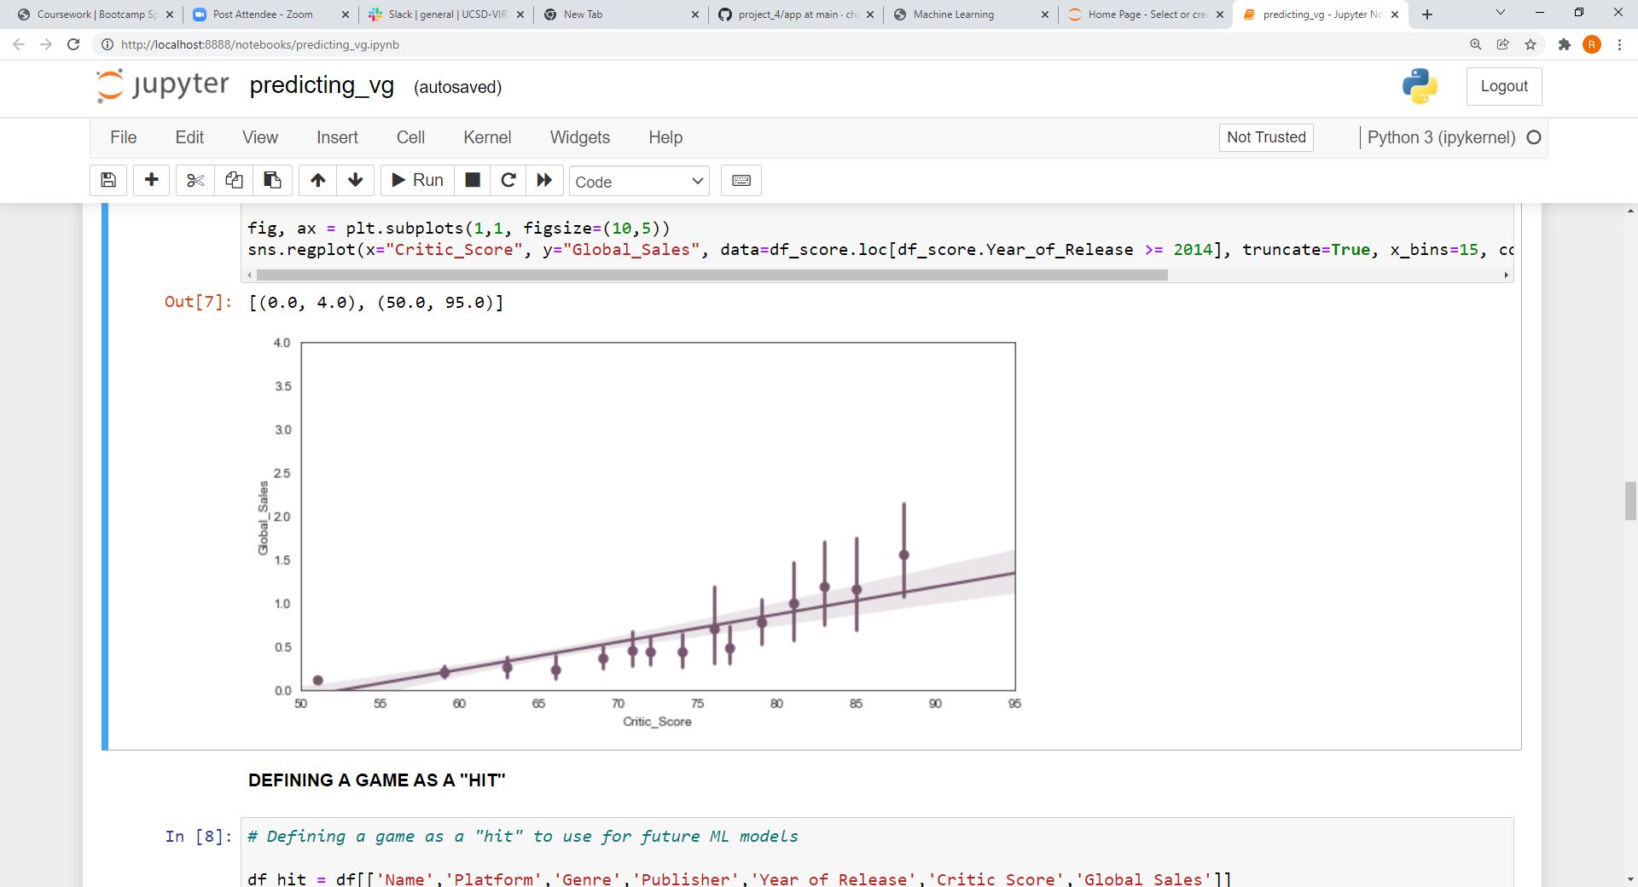

Slide 17
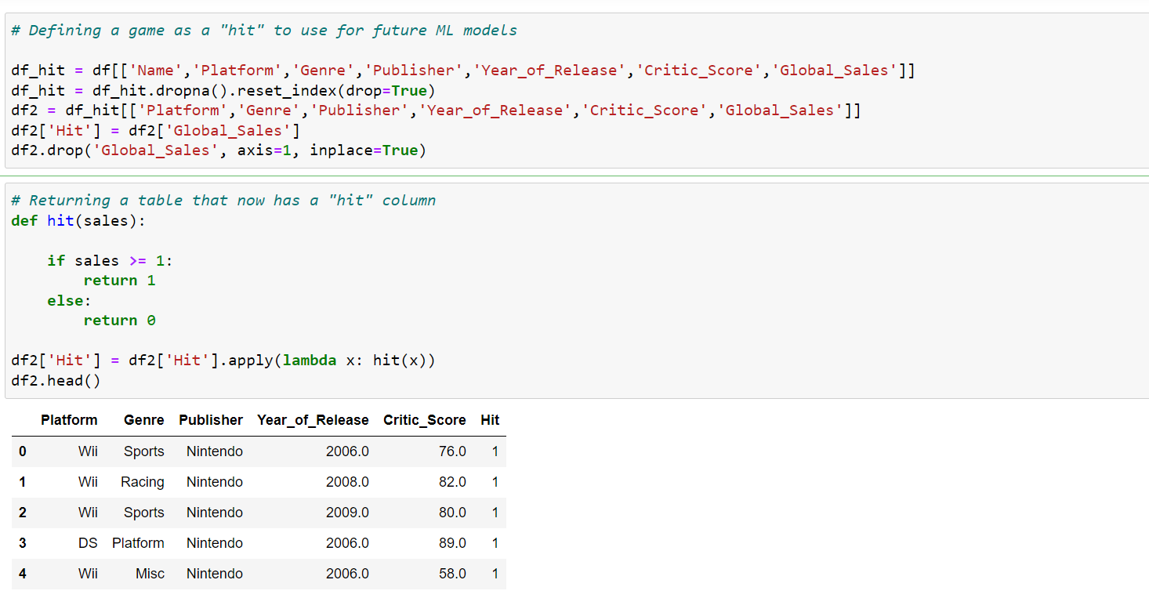

Slide 18
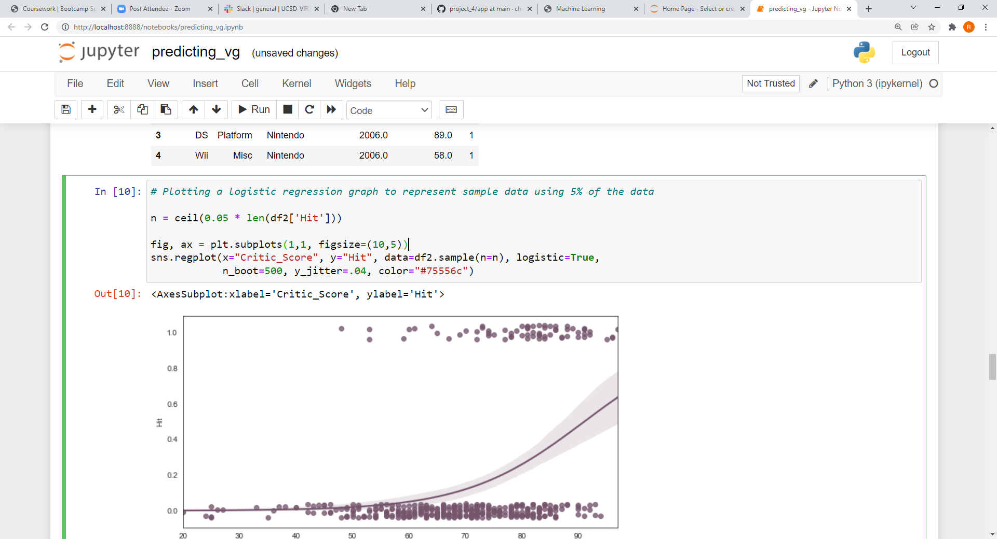
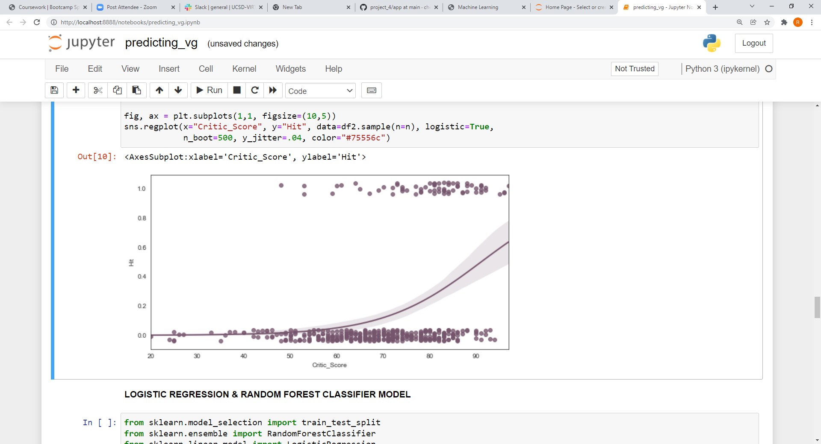

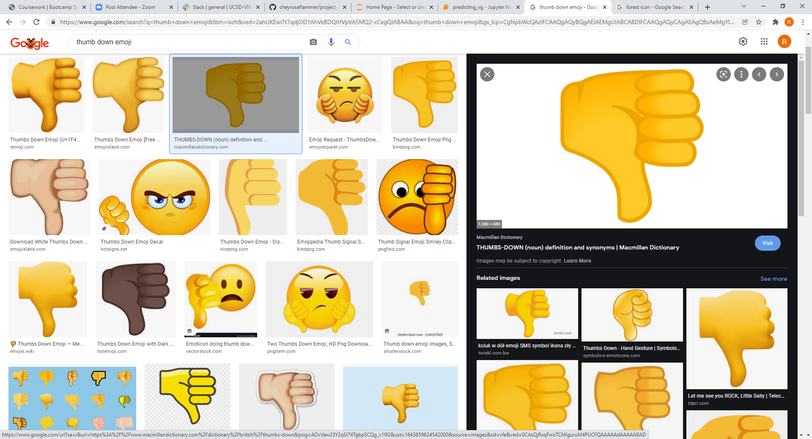

Slide 19
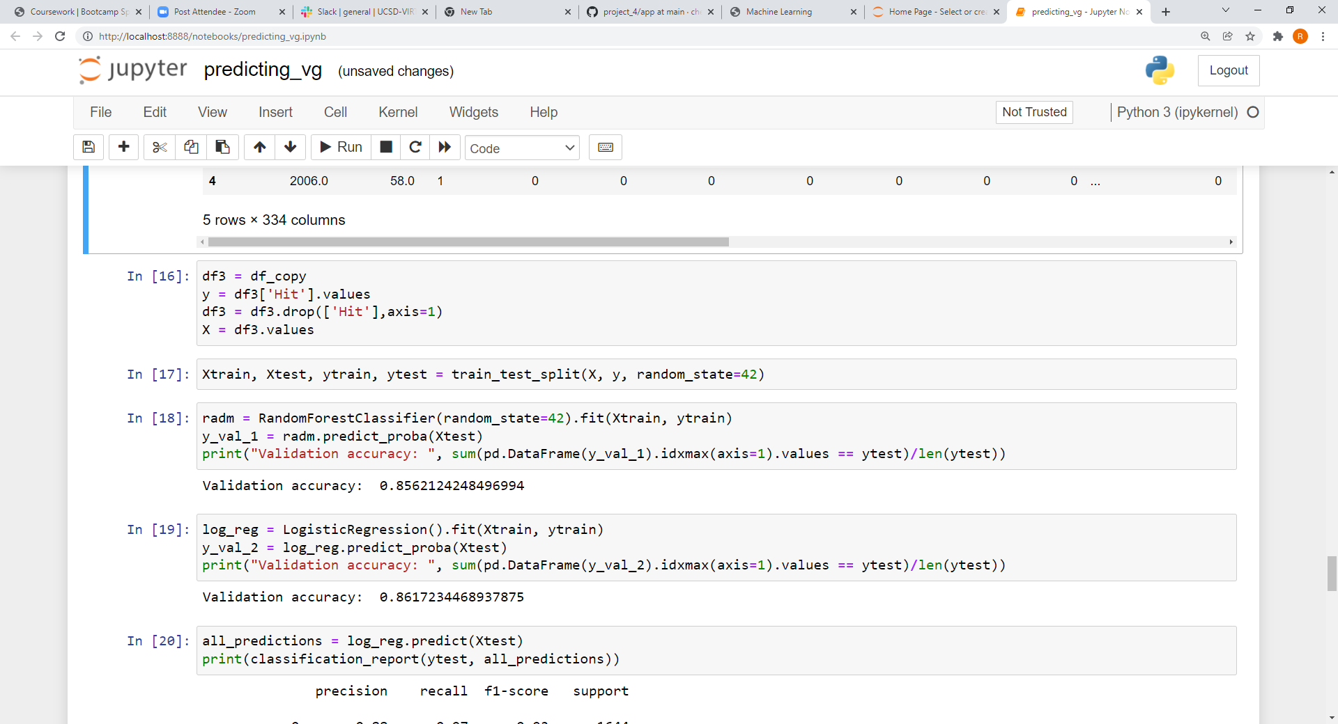


Slide 20
